Slide 1
Squad Up
Product Owner: Zahir Yahya
Scrum Master: Sean Woods
Team: Chuangbo Tong, Shyaan Khan, Collin Fulcher, Tyler Frick
7/24/2018

Slide 2
What is
Squad Up?
Question
Want to play a sport?
Don’t have any friends?
Web application
Locate parks in your area
Allows users to create events at parks
Other users can join!
See current events at that park locations
“A revolutionary way to play sports”
Notes:
Squad Up: a revolutionized way to play sports! Ever want to play a sport but don’t have enough friends to play with, new to an area, or simply have no friends? Squad up is a web app used to help users locate parks in their area to play certain sports together with other users. Squad up allows users to create events at parks to have other users join, and allows users to follow their favorite parks to see current events at that location.

Slide 3
Goals Met
Future Goals
Implemented google logins
Implemented google maps api
Allow user to create events
Allow user to join events
Allow user to input their own parks if not in system
Allow user to search for parks in area
Chat features
Park endorsements/rating
Player endorsements/rating
Live count at park
Guest/User accounts
User’s friends
Facebook login
Notes:
Goals Met:
Implemented google logins
Implemented google maps api
Allow Users to create events
Allow Users to follow parks
Allow Users to input their own parks if not in system
Allow Users to search for parks in area
Future Goals:
Chat features
Park endorsements/rating
Player endorsements/rating
Live count at park
Guest/User accounts
User’s friends
Facebook login

Slide 4
Product
Challenges
Developmental
Challenges
Had to scrap features as time went on
Everyone had different idea in head for final product
Learning new technologies
Did not account for research time (at first)
Changed technologies part way through
More research time
Old technology research time wasted
Unfamiliar with mongodb and databases in general
Unfamiliar with React, and Gatsby
New to the process of creating a web app
Had to learn how pages communicated with each other both frontend and backend
Git pull, push, & merge is scary
Notes:
Final Product:
Had to scrap features as time went on
Everyone had different idea in head for final product
Learning new technologies
Did not account for research time (at first)
Changed technologies part way through
More research time
Old technology research time wasted
Development Challenges:
Unfamiliar with mongodb and databases in general
Unfamiliar with React, and Gatsby
New to the process of creating a web app
Had to learn how pages communicated with each other both frontend and backend

Slide 5
System Demo (Screenshots)

Slide 6
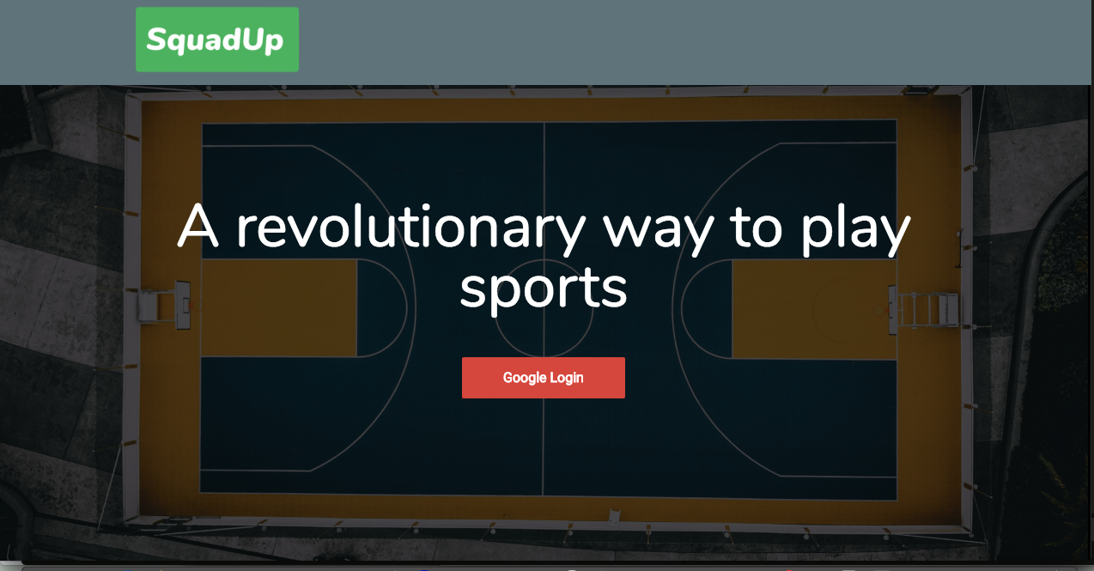
GoogleAuth Api
Gatsby

Slide 7
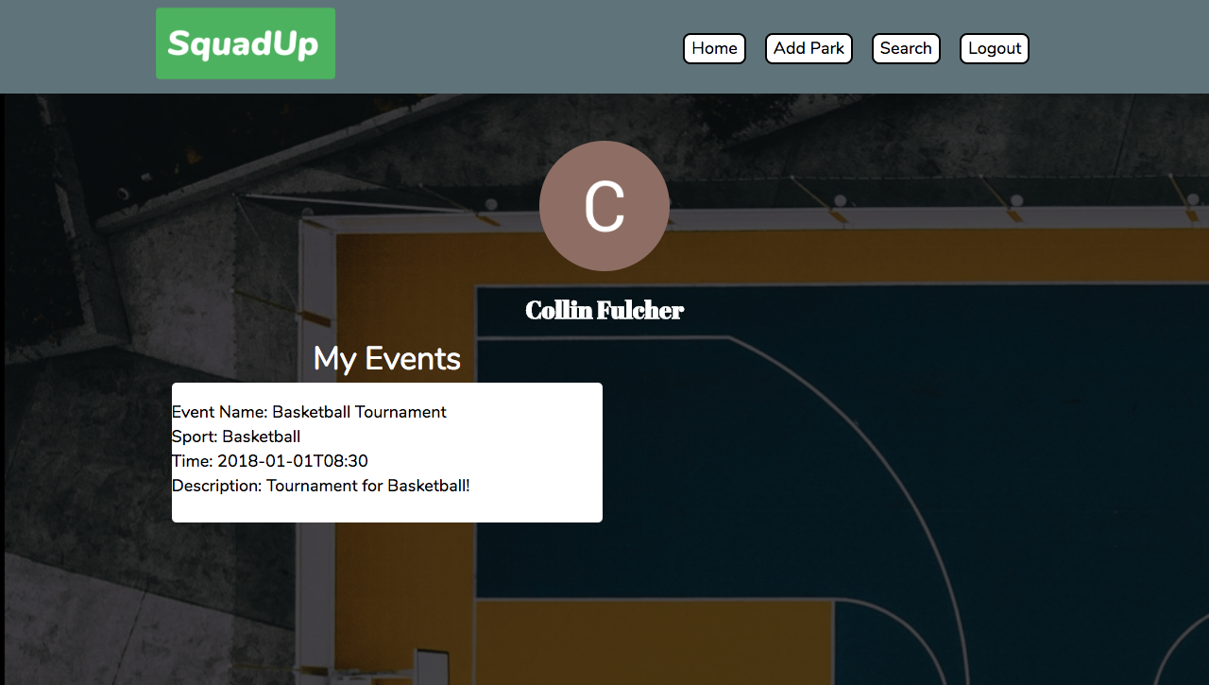

Slide 8
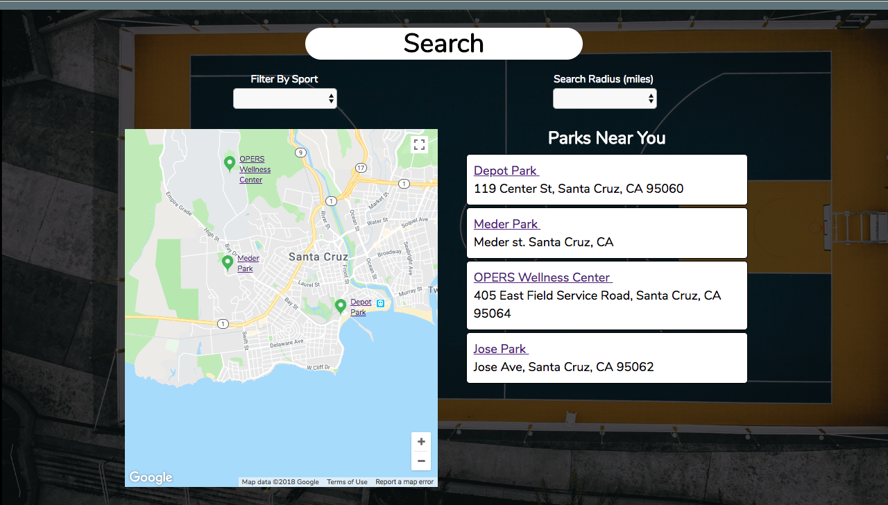

Slide 9
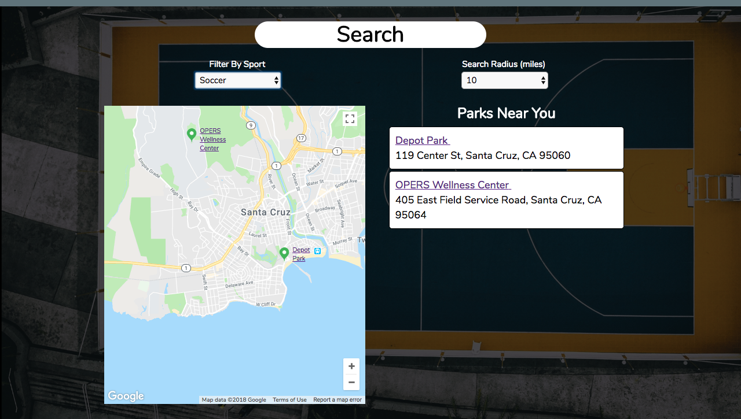

Slide 10
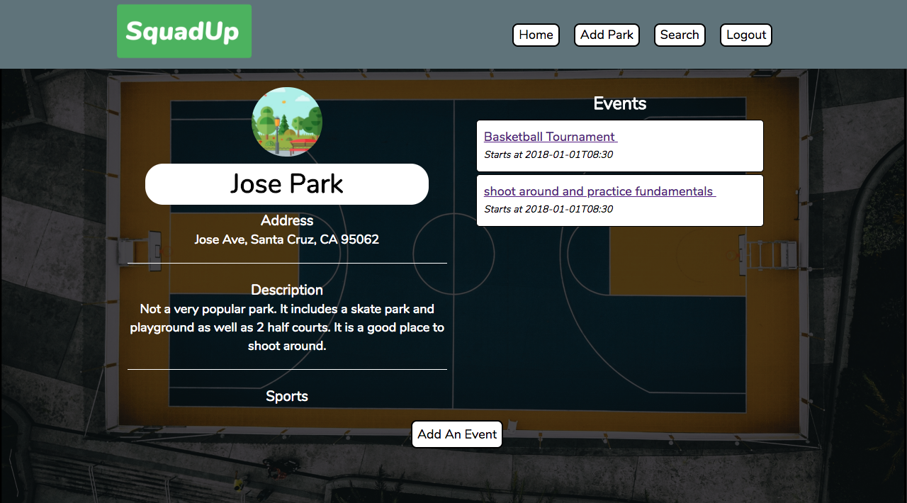

Slide 11
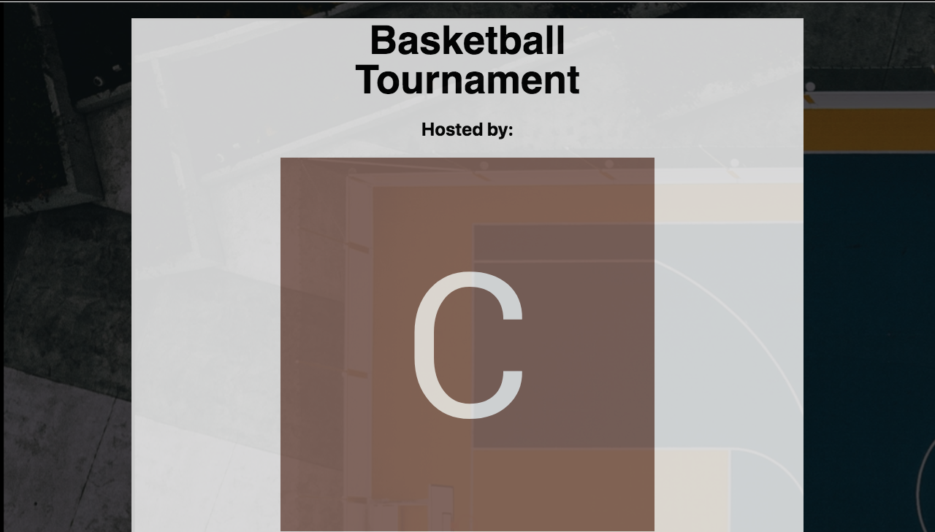
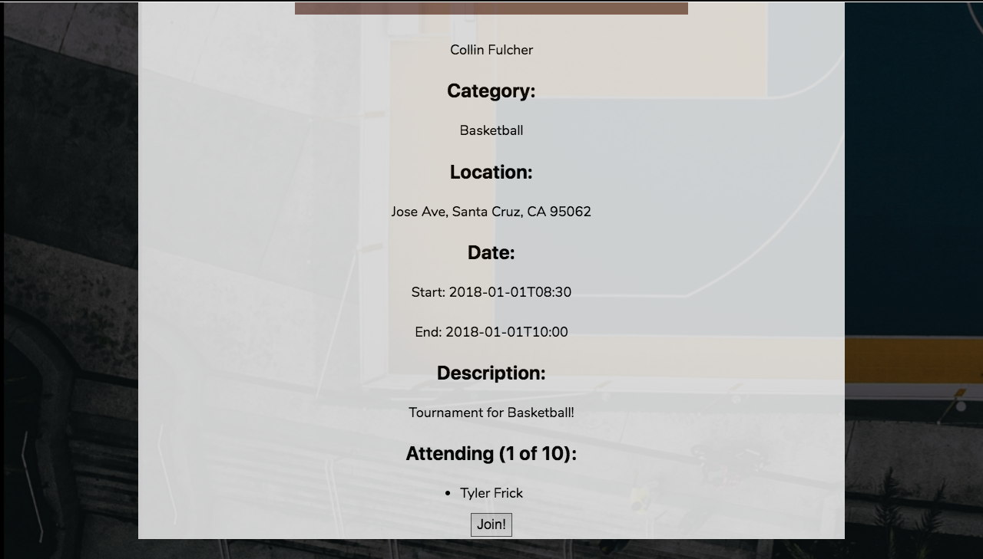

Slide 12
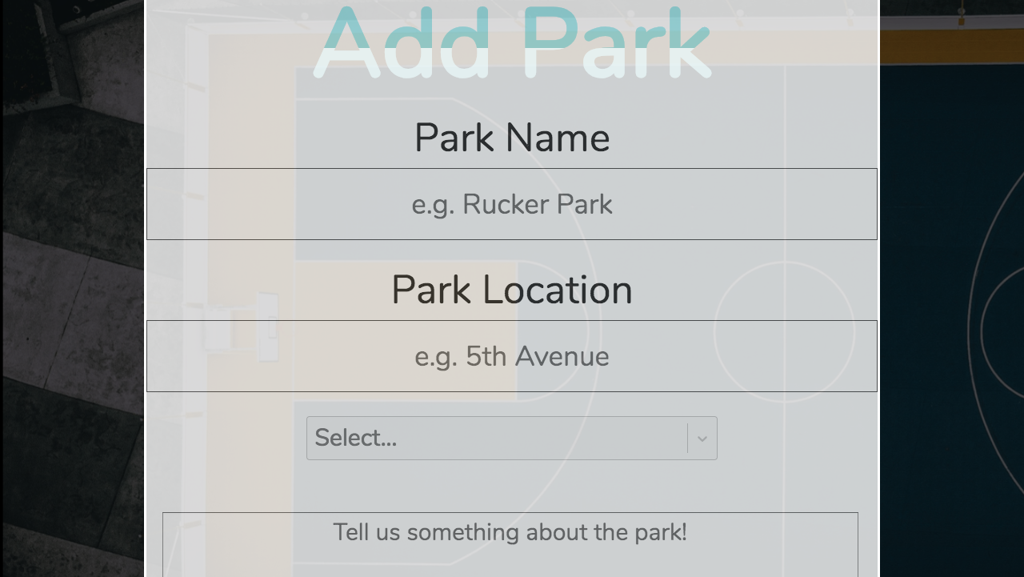

Slide 13
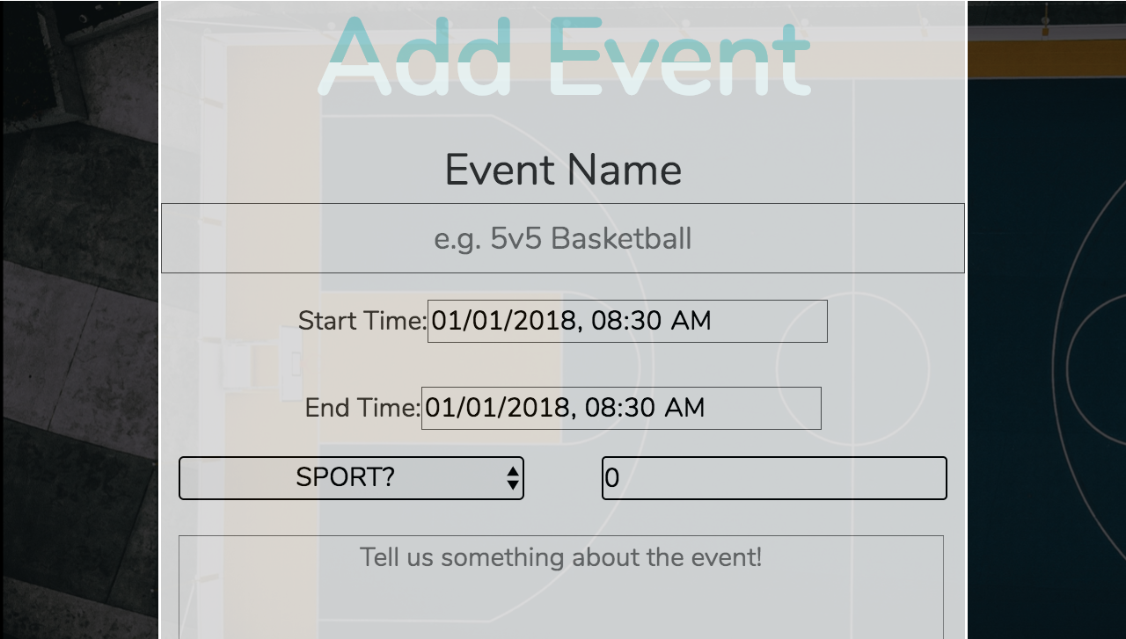

Slide 14
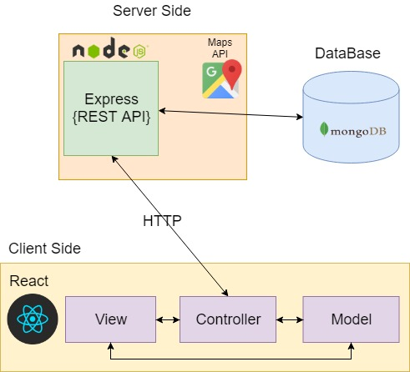
System Overview
GoogleAuth Api
Gatsby

Slide 15
Project Management Techniques
Agile
Scrum
Schedule Planning
Project Jams
Peer Programming

Slide 16
Enjoyed
Hated
Everyone helps each other and works together towards the same goal
Became more familiarized with mongodb and databases
Became more familiarized with React, and Gatsby
Learned the process of creating a web app
Learned how pages communicated with each other both frontend and backend
Learning about more techniques in the middle of the process made it hard to implement them
Rushed schedule, had to cut corners
Couldn’t see TSR’s so hard to improve if a member needed to see them
Notes:
Final Product:
Had to scrap features as time went on
Everyone had different idea in head for final product
Learning new technologies
Did not account for research time (at first)
Changed technologies part way through
More research time
Old technology research time wasted
Development Challenges:
Unfamiliar with mongodb and databases in general
Unfamiliar with React, and Gatsby
New to the process of creating a web app
Had to learn how pages communicated with each other both frontend and backend

Slide 17
Lessons Learned
Notes:
What worked:
Frequent Scrum meetings
Helped identify roadblocks early
Sprint planning
Burndown chart
Helped realize early on sprint 1 was failure
Peer reviewed code
TA demos/ features she wanted to see
What Didn’t work/Stop doing:
Planning poker
Took too much time especially with short sprints
Short sprints
Felt like hard to complete tasks
Too large tasks, should have broken them up more
What we wish we did:
Daily merges
Used MoScoW to set priorities of features early
Unit Tests
More TDD

Slide 18
What worked
Frequent Scrum meetings
Helped identify roadblocks early
Sprint planning
Burndown chart
Helped realize early on sprint 1 was failure
Peer reviewed code
TA demos/ features she wanted to see

Slide 19
What didn’t work
Planning poker
Took too much time especially with short sprints
Short sprints
Felt like hard to complete tasks
Too large tasks, should have broken them up more

Slide 20
Things we wished we had done...
Daily merges
Used MoScoW to set priorities of features early
Unit Tests
More TDD

